Slide 1
Estimation
Econometría. ADE.

Slide 2
Estimation
We assume we have a sample of size T of:
The dependent variable (y)
The explanatory variables (x₁,x₂, x₃, …, x_{k}), with x₁ being an intercept (a column vector of 1s)
We also have a vector of unknown parameters β=(β₁, β₂, …, β_{k})’
We have a perturbation vector (u) of dimension T
A set of hypothesis about the relationship between X, β and u.

Slide 3
Estimation
In these circumstances, we can link the dependent and the explanatory variables as follows:
Y_{t} = β₁ + β₂ x_{2t} + … + β_{k} x_{kt} + u_{t}
Matrix form: Y = Xβ + u
Compact form: Y_{t} = x_{t}’ β + u_{t}
Our key problem is to provide value to the components of the vector β

Slide 4
Estimation
To assign values to the parameters, we have some options.
We can invent them.
We can phone Rappel and ask him for the more appropriate values according to his “view”.
We can use a random procedure.
We can estimate them.

Slide 5
Estimation
Estimation theory is a branch of statistics that deals with providing values to a set of parameters based on measured/empirical data that has a random component.
An estimator attempts to approximate the unknown parameters using the measurements.

Slide 6
Estimation
Estimation methods
Maximum likelihood
Ordinary Least Squares
Non-linear methods
GMM
Which one will we use along the course?

Slide 7
Estimation
Do you know this John Ford’s film?
There is a very famous scene where cowboys escape from redskins by crossing the Rio Grande river. (28:05)
Do they use a least squares principle?

Slide 8
Estimation
We have the following the relationship:
Y = X β + u
Thus, we can express it as follows:

Slide 9
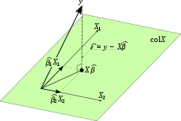

Slide 10
Estimation
The OLS estimator

Slide 11
Estimation
Then,
The projection matrix is: P_{X} = X(X’X)⁻¹X’
The residual matrix is: M = I - P_{X} = I - X(X’X)⁻¹X’
P_{X} and M are orthogonal
P_{X} is symmetric (P_{X}= P’_{X} )
P_{X} is idempotent (P_{X} P_{X}= P_{X} )

Slide 12
Estimation
Consequently, we have that:

Slide 13
Estimation
By simply comparing the equation, we obtain the expression of the ordinary least squares (OLS) estimator:

Slide 14
Estimation
We can alternatively obtain this same result by simply applying the least squares principle:
We need to get the combination of values of the estimation vector that minimizes the sum of the squared residuals.
Analytically, this implies to solve this:

Slide 15
Estimation

Slide 16
Properties of the LS Estimator
We have obtained the LS estimator. But, is good enough this estimator?
Properties
Unbiased
BLUE
Consistent
Efficient

Slide 17
Properties of the LS Estimator
It is advisable to express the LS estimator as follows:

Slide 18
Properties of the LS Estimator
Thus, we have that:
The OLS estimator vector is unbiased

Slide 19
Properties of the LS Estimator
The variance of the estimator vector is

Slide 20
Properties of the LS Estimator
The OLS estimator is BLUE
Best Linear Unbiased Estimator
This implies that it has the lowest variance, as compared to other unbiased, linear estimators.
Gauss-Markov theorem helps us to prove it.

Slide 21
Properties of the LS Estimator
The LS estimator is consistent if we can prove that:
Or equivalently

Slide 22
Properties of the LS Estimator
The use of plim’s can help us to prove consistency, given that:

Slide 23
Properties of the LS Estimator
We can employ an alternative method to prove consistency. An estimator is consistent if:
It is asymptotically unbiased
Its variance goes to zero when the sample grows to infinity.

Slide 24
Properties of the LS Estimator
The first condition is held by simply considering that:

Slide 25
Properties of the LS Estimator
The second condition also holds.

Slide 26
Properties of the LS Estimator
We can also follow a very intuitive approach. If an estimator is consistent, we have that:
The estimator asymptotically collapses towards a value, which is the true value of the parameter.
Thus, the differences between estimator and true value of the parameter vanishes.
It is also true that the higher the sample size, the more information available to estimate the model.

Slide 27
Properties of the LS Estimator
Let us consider that the observations of a dependent variable are generated by the following model:
T={10, 50, 100, 500, 1000}
The perturbation is generated by a N(0,1) distribution

Slide 28
Properties of the LS Estimator
Then, we estimate by OLS the following model
The results we have obtained are reported in next Figures.

Slide 29
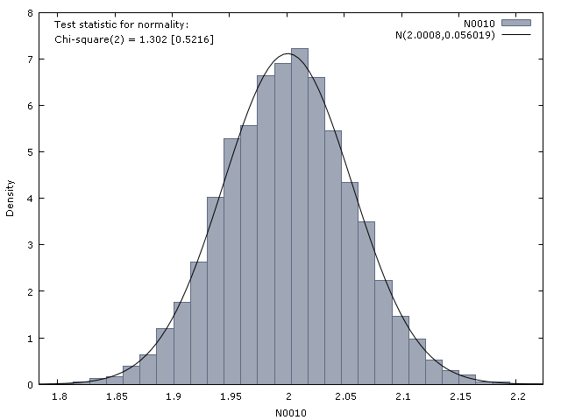

Slide 30
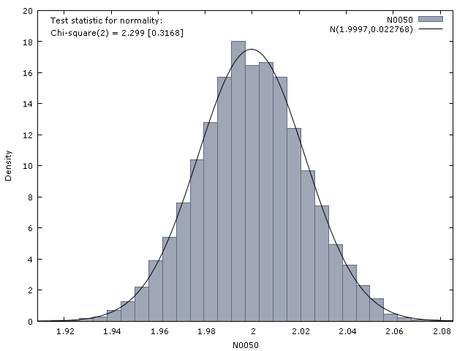

Slide 31
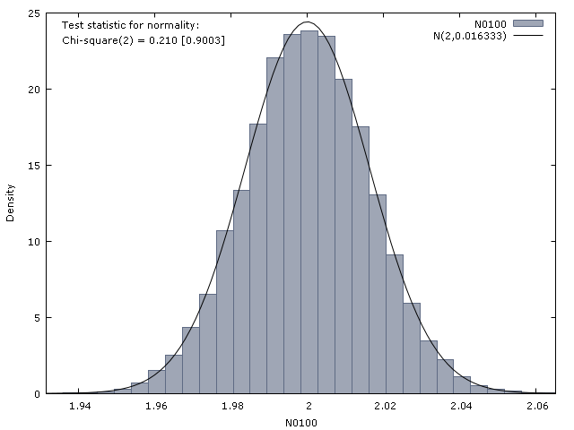

Slide 32
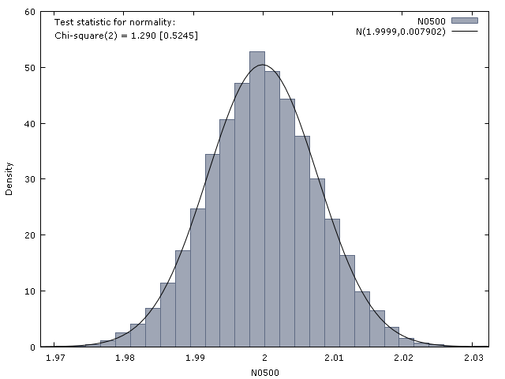

Slide 33
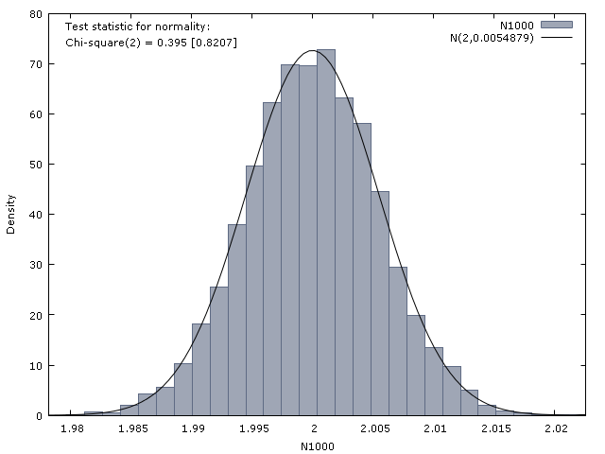

Slide 34
Properties of the OLS estimator. Efficiency
An estimator is efficient if it has the lowest variance, compare to other unbiased estimators.

Slide 35
Properties of the OLS estimator. Efficiency
To prove it:
We should impose that the perturbation follows a normal distribution
We should then obtain the Cramer-Rao bound.

Slide 36
Properties of the OLS estimator. Efficiency
We should compare the Cramer-Rao bound with the variance of the OLS estimator.
For the OLS estimator vector, the Cramer-Rao bound is σ² (X’X)⁻¹.
It coincides with the covariance matrix of the OLS estimator vector.
Consequently, the OLS estimator is efficient.

Slide 37
OLS estimator of the variance of the perturbation.
If we assume that the perturbation vector follows a N(0, σ² I) distribution, we have that the vector y follows a N(Xβ,σ² I) distribution.
We already know how the vector β can be estimated
We need now to get an estimator of the variance of the perturbation (σ²)
We can use the OLS approach

Slide 38
OLS estimator of the variance of the perturbation.
The OLS estimator can be defined as follows:
With being the sum of the squared residuals (SSR)

Slide 39
OLS estimator of the variance of the perturbation.
This estimator shows the following properties:
It is unbiased
It is NOT linear
It is consistent
It is NOT efficient

Slide 40
Maximum Likelihood estimator
The ML estimation selects the set of values of the model parameters that maximizes the likelihood function.
Assuming all the previous hypothesis, the joint density function of (y₁, y₂, …, y_{T}) can be expressed as follows:

Slide 41
Maximum Likelihood estimator
Then, the likelihood function can be stated as follows:
Which is the difference with respect the joint density function?

Slide 42
Maximum Likelihood estimator
To obtain the ML estimators, we should first the log-likelihood function
Then, we should obtain the values of the parameters that maximize this function

Slide 43
Maximum Likelihood estimator
The solutions to this optimization problem are:
The ML estimator and the OLS estimator coincide.
Both have the same properties.

Slide 44
Maximum Likelihood estimator
The ML estimator of the variance of the perturbation is:
It is consistent
It is not unbiased, linear, efficient
It has asymptotical good properties (it is a MLE)

